Slide 1


Submitted By: -
Ekhlakh Ahmad.
Reg No.: - 12209166.
Submitted To: -
Sarabjit Kumar Sir

Slide 2
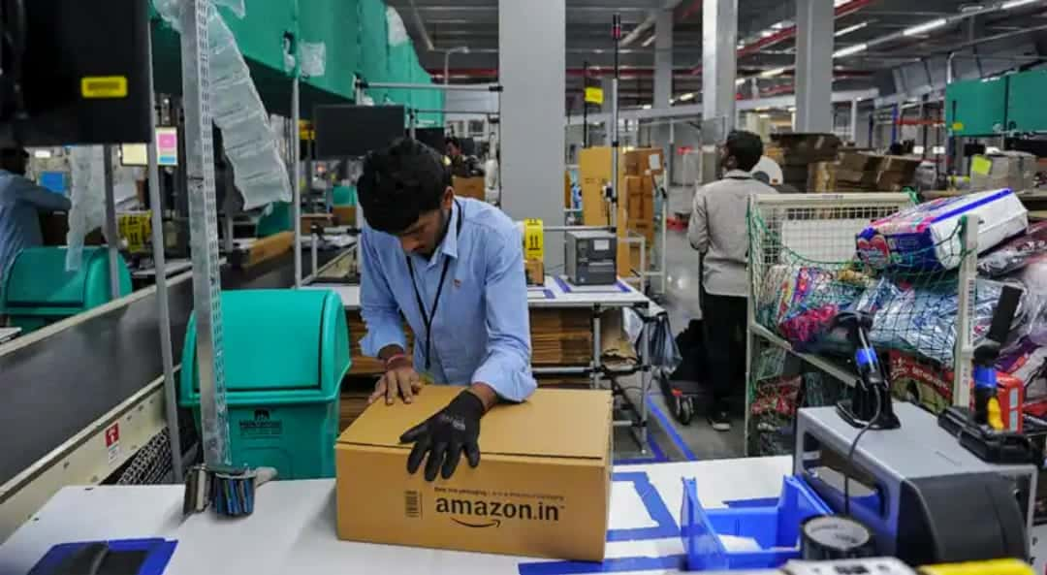
Brief About Company
Amazon is the World’s largest online retailer and a prominent cloud service provider.
Amazon is an American online business and cloud computing company.
It was founded on July 5, 1994 by Jeff Bezos.
Amazon is a vast Internet-based enterprise that sells books, music, housewares, electronics and many other goods.
By 1998, Amazon’s revenues had reached an impressive $600 million.
Amazon has also adopted automated processes for firing, as well as hiring.

Slide 3
Year of Existence with History.
It was founded on July 5, 1994 by Jeff Bezos.
On July 5, 1994 Bezos initially incorporated the company in Washington state with the name Cadabra.
After a few months, he changed the name to Amazon, Because a lawyer misheard its original name as “CADABER”.
On July 16, 1995, Amazon opened as an online bookseller, selling the world’s largest collection of books to anyone with World Wide Web Access.
Amazon was selling books in all 50 US states and 45 countries.
1997: Amazon.com debuts on the web.
By 1998, Amazon’s revenues had reached an impressive $600 million.
1999: The firm expands into selling toys, electronics, tools, and hardware, Bezos is named Time Magazine’s “person of the Year”.

Slide 4


Amazon old LOGO
Amazon New LOGO

Slide 5
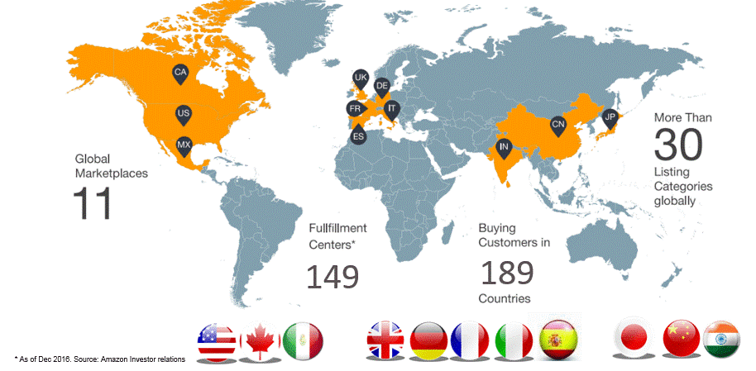
Country of Origin & Countries for Business.
Amazon is an USA(United State of America) company. As we know that it was started in Washington (America). So its origin is America.
Amazon currently has international marketplace centres in 15 countries.
There are some company country-
U.S
Canada.
U.K.
Germany.
France.
India. Etc.
But they shipped to over 200+ countries.

Slide 6
Revenue as per the NSE/NYSE(Last 5 Years).
Year | Revenue | Change
2022 | $485.90 B | 3.42%
2021 | $469.82 B | 21.7%
2020 | $386.06 B | 37.62%
2019 | $280.52 B | 20.45%
2018 | $232.88 B | 30.93%

Slide 7
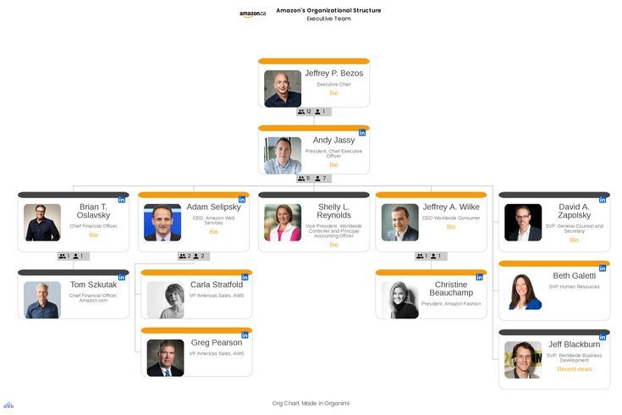
Leadership Hierarchy of the company

Slide 8
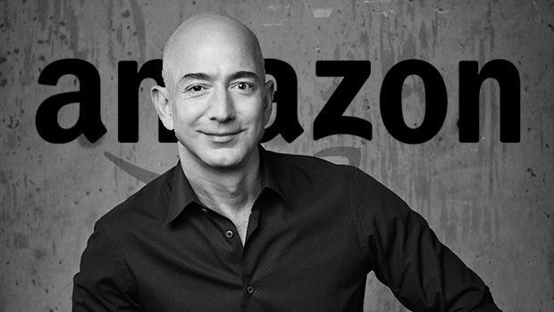
Jeff Bezos founded Amazon.com in 1994. Amazon’s mission is to be Earth’s most customer centric company. Amazon offers low prices and fast delivery on millions of items, provides thousands or movies and TV shows through Prime Video, designs and builds the bestselling kindle, fire and echo devices.
Jeffrey P. Bezos

Slide 9
References of LPU Alumni working Company
Name | Company Name | Linkedin ID, E-mail ID

Slide 10
Employee Base (Country wise)
Amazon total number of employee in 2022 was 1,608,000
Amazon total number of employee in 2020 was 1292000
Amazon total number of employees in 2019 was 798000.
Amazon total number of employee in 2028 was 647.500

Slide 11
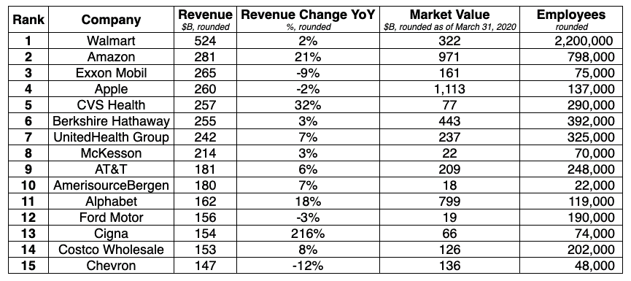
Rankings of the company(Forbes Fortune 500 etc).

Slide 12

Technologies used in the Amazon

Slide 13
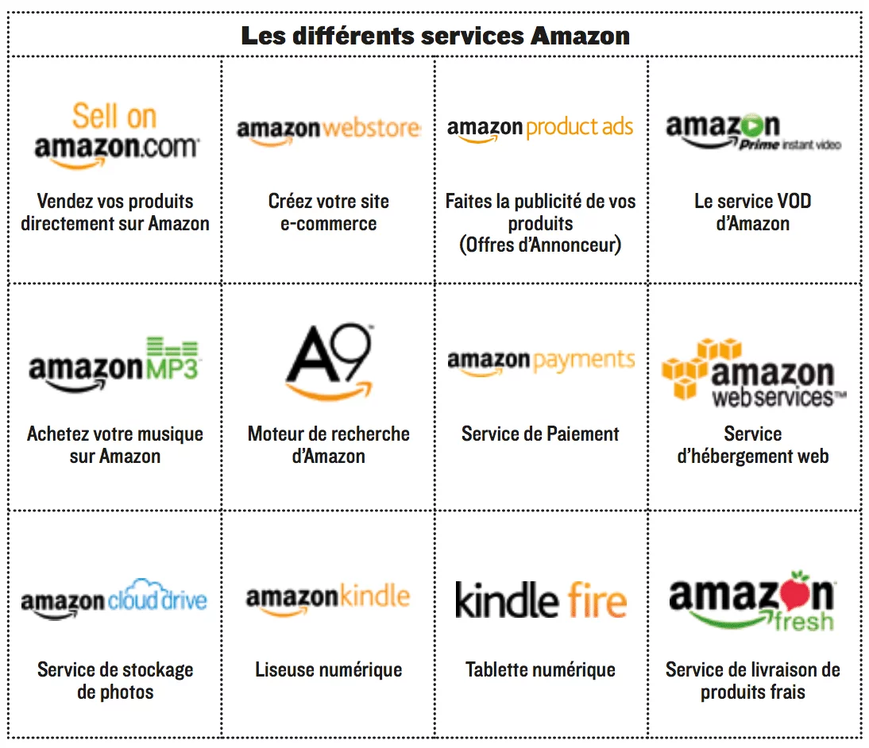
Major Products of the amazon with Clients.

Slide 14
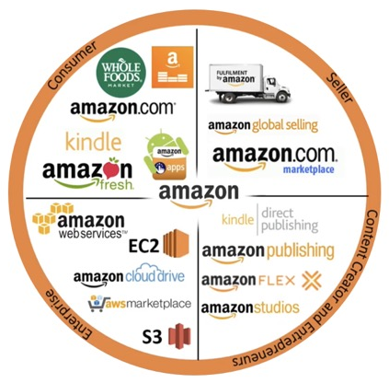
Major Services by the amazon with Clients.

Slide 15
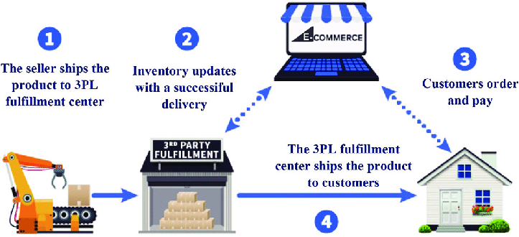
Operational verticals of the amazon with clients

Slide 16
Role you are interested with amazon
Amazon is a fast-paced company that has very high expectations of its employees.
Many aim to get at job at this US multinational technology company.
Because this a top company in the field/industry.
This company have a great reputation for customer service.
This company known for being a great place to work. Etc.

Slide 17
Packages offered by amazon for role
Job Title | Range | Average
Customer Service Associate | Rs. 162K – Rs. 403K | Rs. 252,293
SDE | Rs. 737K – Rs. 4m | Rs. 1643476
Operations manager | Rs. 562K – Rs 3m | Rs. 1244973
Software Engineer | Rs. 453K – Rs. 4m | Rs. 1270557
Data Analyst | Rs. 234K – Rs. 826K | Rs. 441145

Slide 18

Visits company gave to LPU Campus

Slide 19
Pros & Cons of the company you have considered for you
You have financial security
You get more perks and benefits
There are well-defined processes
You will have a better status
There are more career development opportunities
The cons of working for a large company

Slide 20
List of the references weblinks, articles etc.
https://www.careeraddict.com/
https://www.quora.com/
https://www.wikipedia.org/
https://w3techs.com/
https://www.aboutamazon.com/
https://www.linkedin.com/

Slide 21
The End
Thanks

